Slide 1
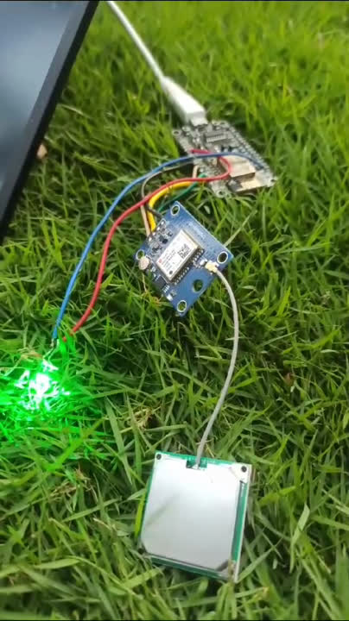

V2V FOG
NAVIGATION SYSTEM
VEHICLE-TO-VEHICLE FOG NAVIGATION SYSTEM LEVERAGING IOT AND GPS TECHNOLOGY TO PREVENT COLLISIONS BY ENABLING REAL-TIME COORDINATION DURING DENSE FOG.
Shahnawaz Alam - 12203467

Slide 2
INTRODUCTION
Fog reduces road visibility, increasing accident risks
Uses IoT and GPS for safer navigation in low visibility
Real-time vehicle communication to share road data
Improves safety in fog-prone areas

Slide 3
Problem Identification
Driving in foggy conditions is one of the most dangerous challenges on the road due to:
Severely Reduced Visibility
Inadequate Reaction Time
Lack of Communication Between Vehicles
High Accident Rates in Fog-Prone Areas

Slide 4
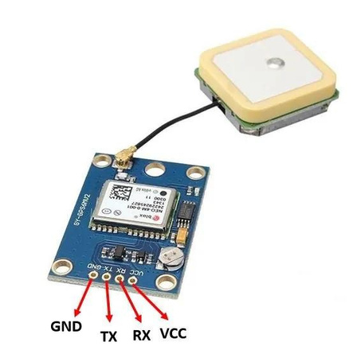
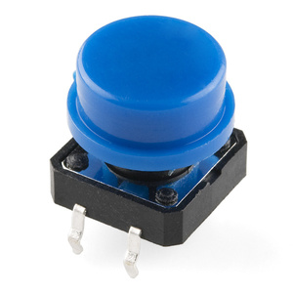
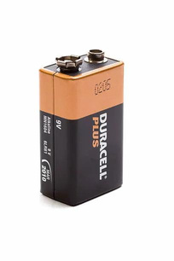
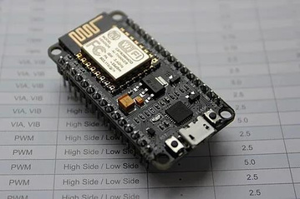
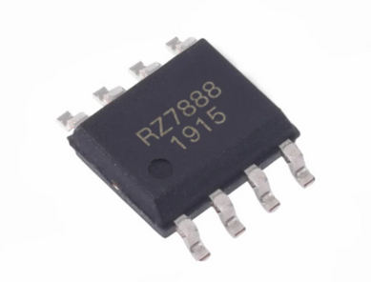
COMPONENTS
2 Node MCU-₹275/NodeMCU
2 NEO6M GPS-₹270/NEO6M
RZ7888 Motor Driver-₹160
3 LED- ₹15
3 Switch-₹45
2 Battery 9V-₹90

Slide 5
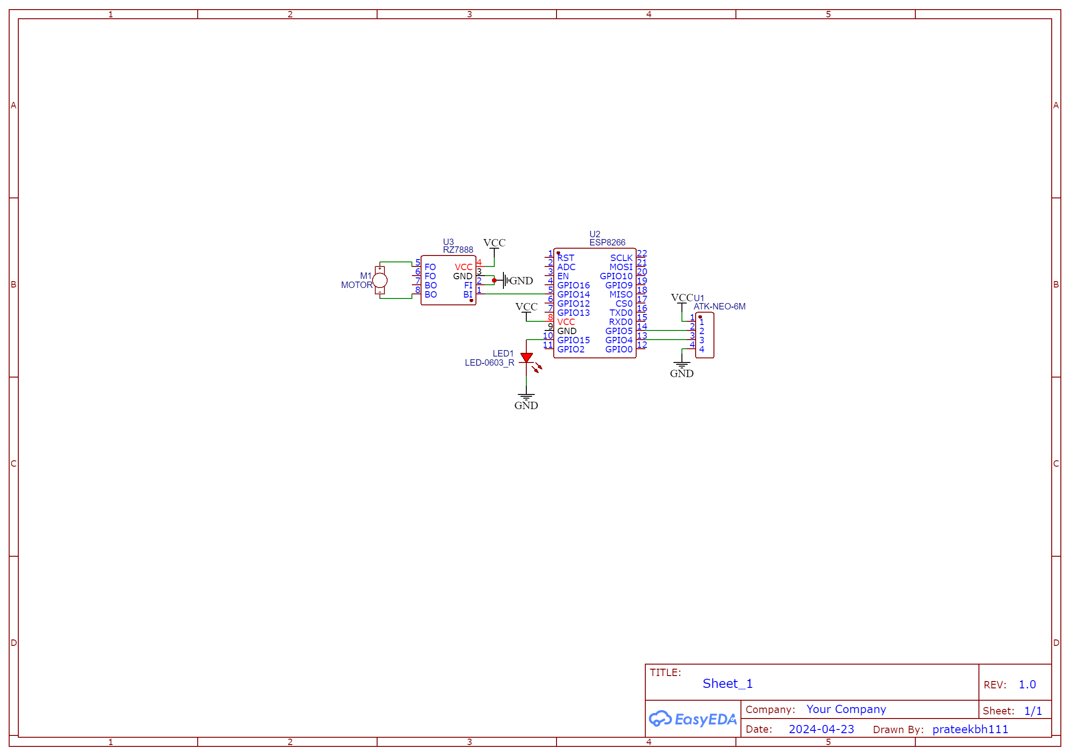
CIRCUIT DIAGRAM
Connections between NodeMCU, GPS, motor driver, motor, and LEDs

Slide 6
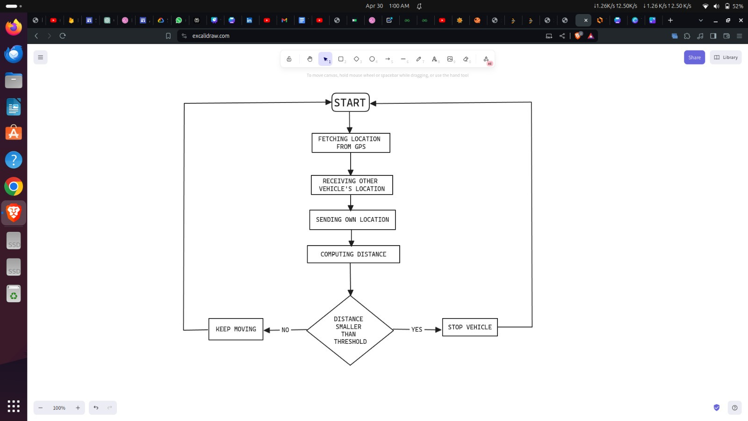
FLOW CHART
Visual representation of V2V real-time communication and navigation

Slide 7
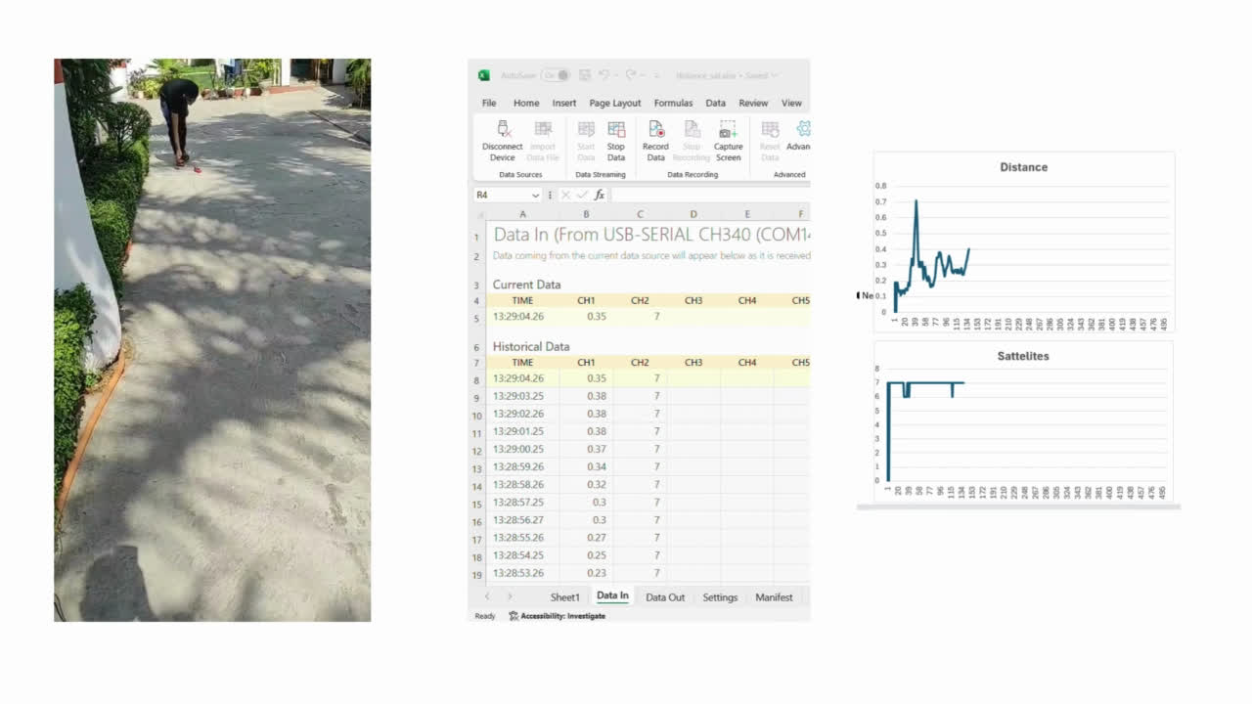
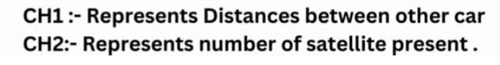
Real-Time Demonstration: V2V Fog Navigation System in Action

Slide 8
ADVANTAGES
Low-cost operation
Better performance in low visibility regions
Interconnected network of self driving cars
Real time data sharing

Slide 9
DISADVANTAGES
Satellite Connectivity Issues
Difficulty in Highway Mapping
Wi-Fi Communication Constraints
Power Consumption Concerns

Slide 10
APPLICATIONS
Enhancing Road Safety
Optimizing Cargo Operations
Mitigating Traffic Congestion
Reducing Economic Losses

Slide 11
FUTURE SCOPE
Advanced Sensor Integration
Machine Learning for Dynamic Navigation
Expansion to Autonomous Vehicles
Enhanced Data Analysis Techniques

Slide 12
CONCLUSION
Enhances road safety in fog
Enables real-time V2V coordination
Supports smart transportation infrastructure
Reduces accidents and economic losses

Slide 13
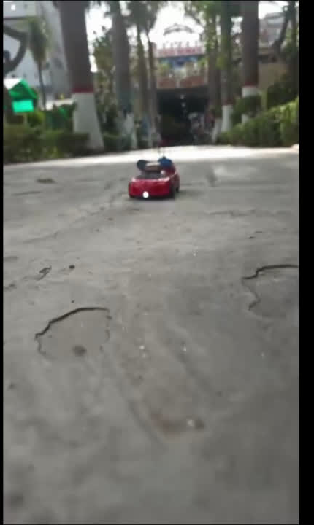
Thank you

